Slide 1
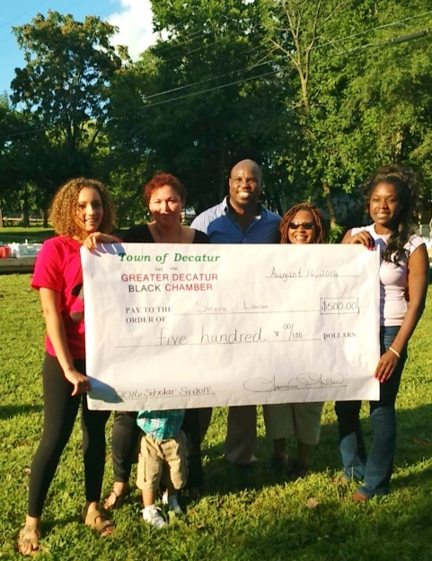
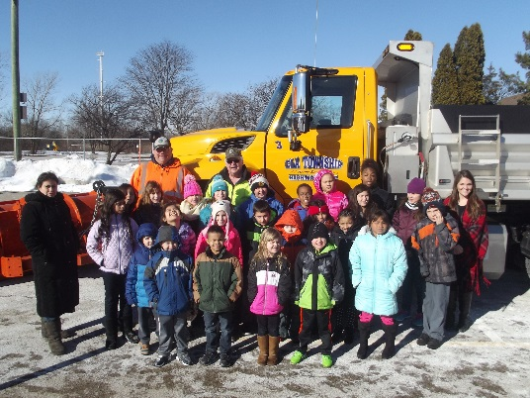
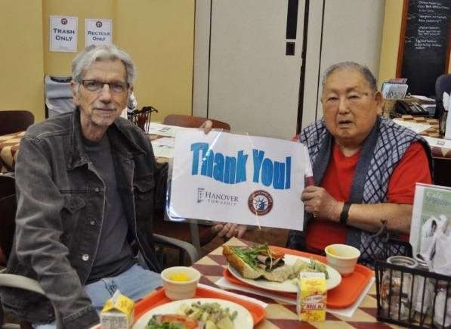
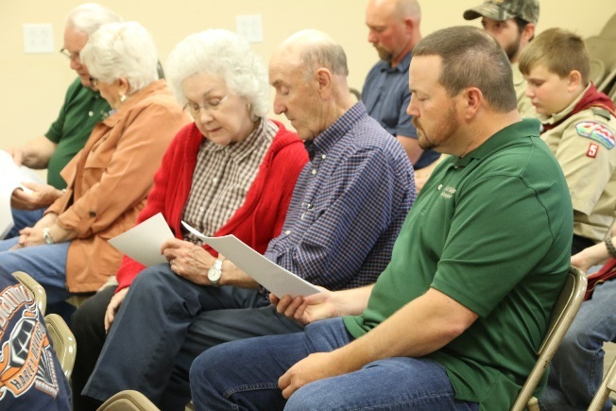
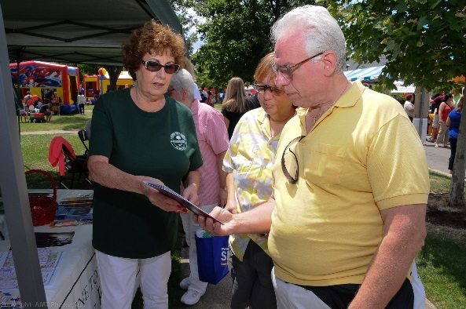
TOI Annual Education Conference
November 13-15, 2016
Springfield, Illinois

Slide 2
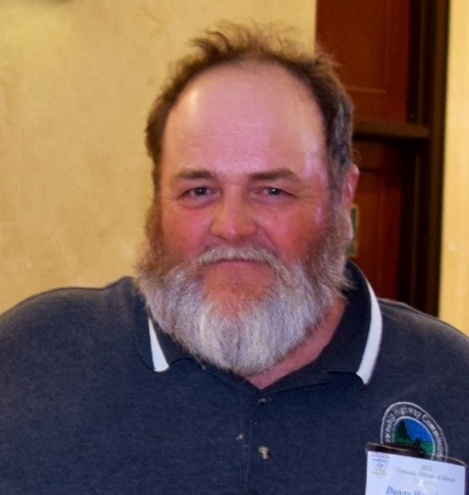
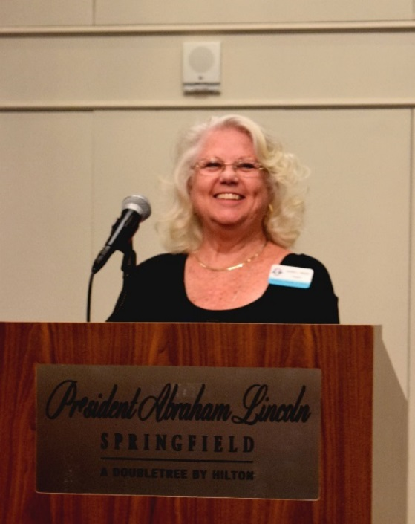
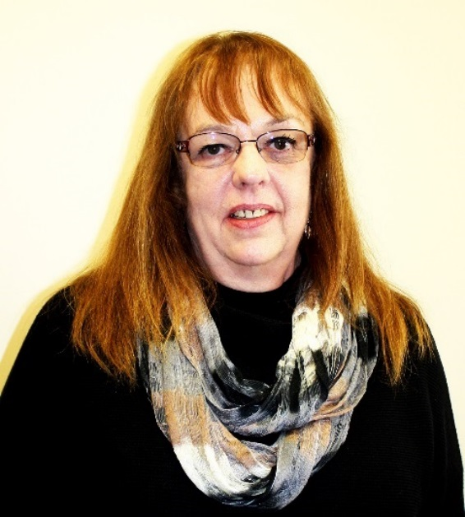
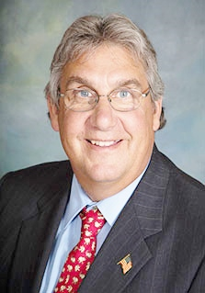
2016 Board of Directors
3rd Vice President Danny Hanning
Highway Commissioner Huntsville Township Schuyler County
Secretary
Susan Curtiss
Supervisor Esmen Township Livingston County
President Karen L. Reese
Assessor Newell Township Vermilion County
1st Vice President
Robert J. Miller
Highway Commissioner Algonquin Township McHenry County

Slide 3
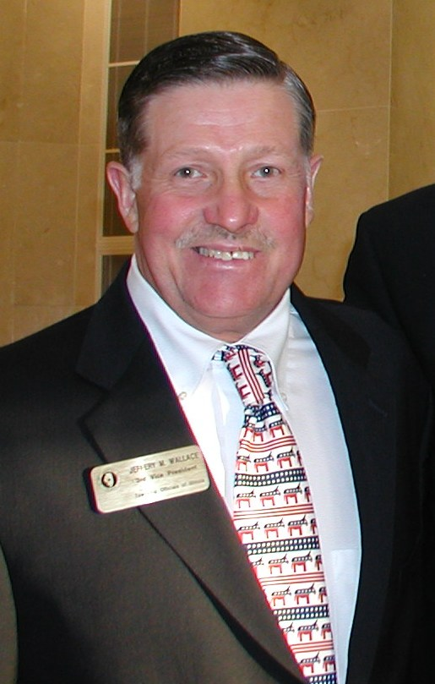
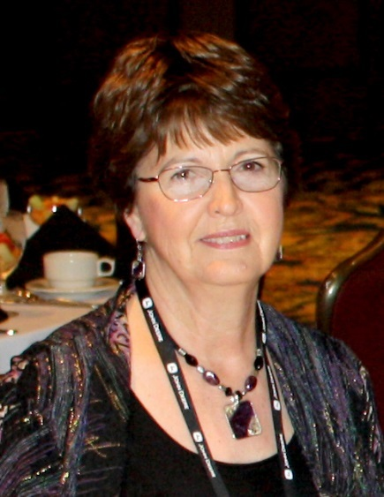
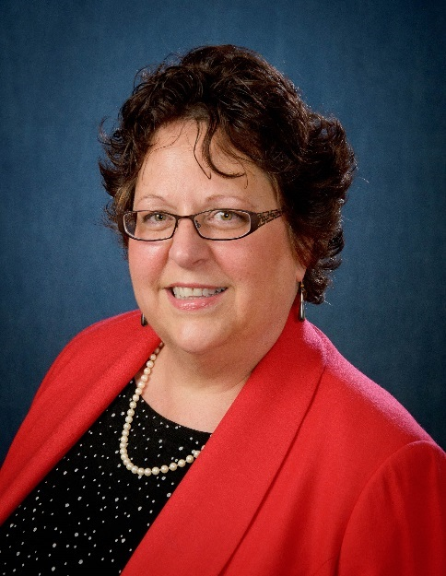
M. Carroll Carroll
Tax Collector Brimfield Township Peoria County
Immediate Past President Jeff Wallace
Trustee Joliet Township Will County
Treasurer Judy Herrman
Clerk Spring Lake Township Tazewell County
Katy Dolan Baumer
Clerk
Hanover Township
Cook County

Slide 4
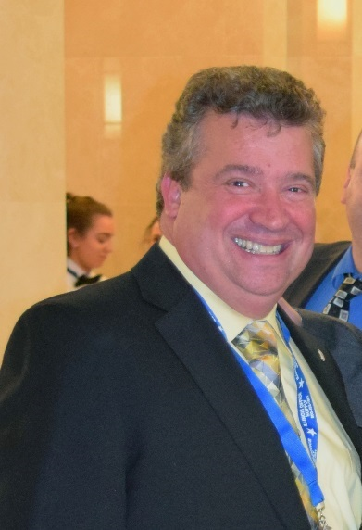
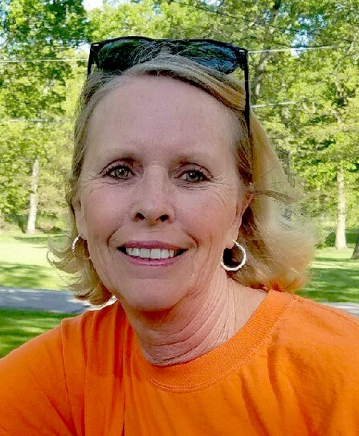
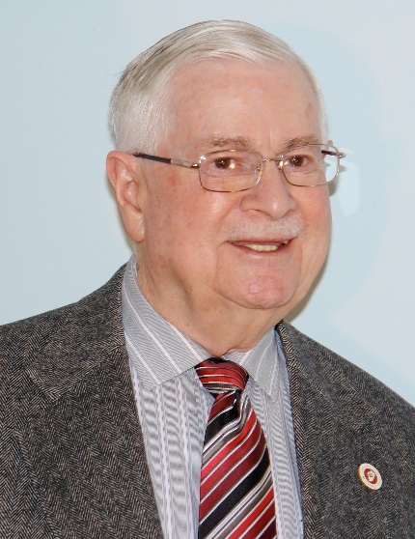
John Dabrowski
Assessor
Bloomingdale Township
DuPage County
Christine Filbert
Highway Commissioner
Cordova Township
Rock Island County
William Donnan
Clerk
Ela Township
Lake County
Mike Foley
Trustee Venice Township Madison County

Slide 5
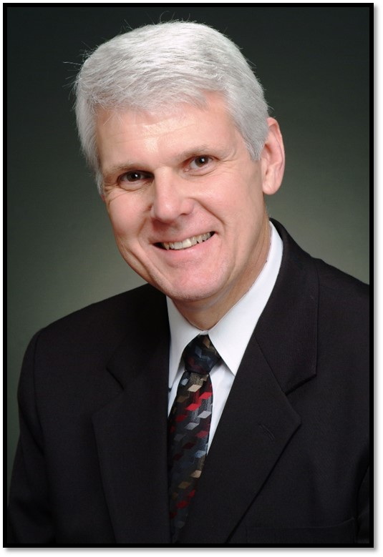
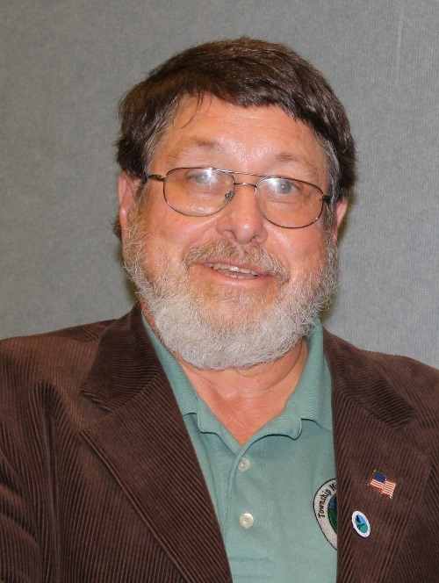
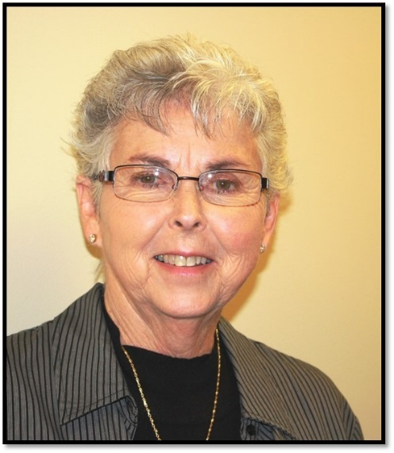
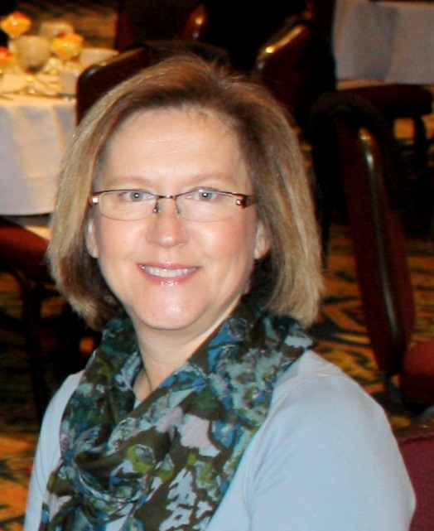
Leslie Hild
Highway Commissioner
Mt. Pulaski Township
Logan County
Mickey Goral
Supervisor Rockford Township Winnebago County
Mary Hamilton
Trustee
Aetna Township
Logan County
Lisa Hodge
Clerk
Blackberry Township
Kane County

Slide 6
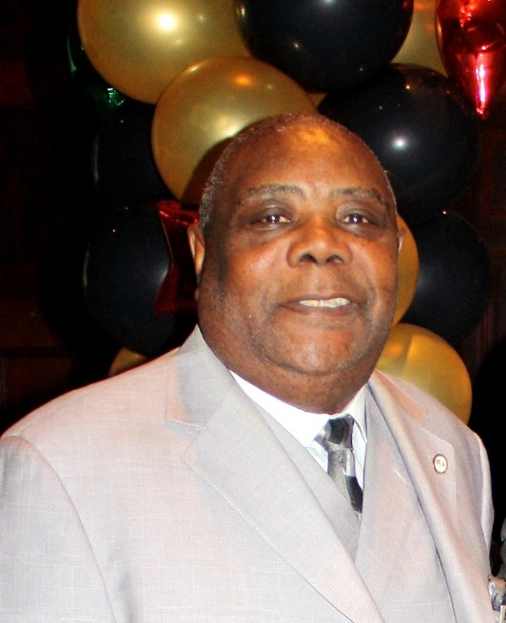
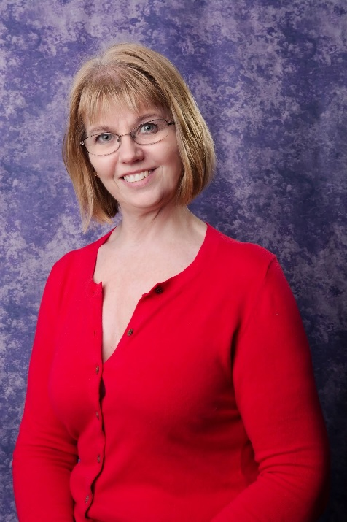
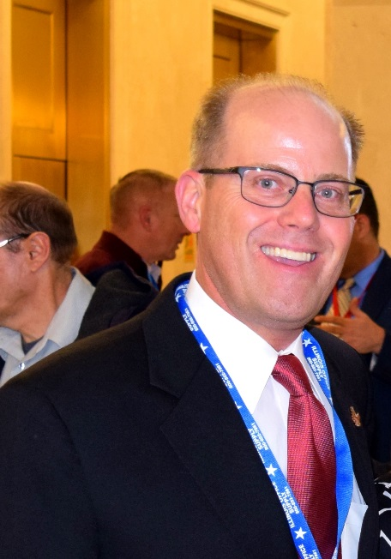
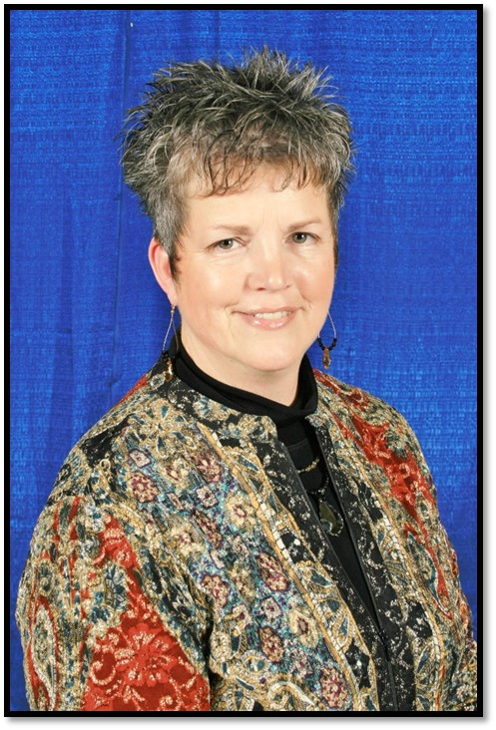
Percy Johnson
Trustee Waukegan Township Lake County
Sherrill Knorr
Supervisor
Reed Township
Will County
Christopher Kain
Assessor
Addison Township
DuPage County
Deb Lane
Multi-Township Assessor
Meriden/Ophir/Troy Grove Townships
LaSalle County

Slide 7
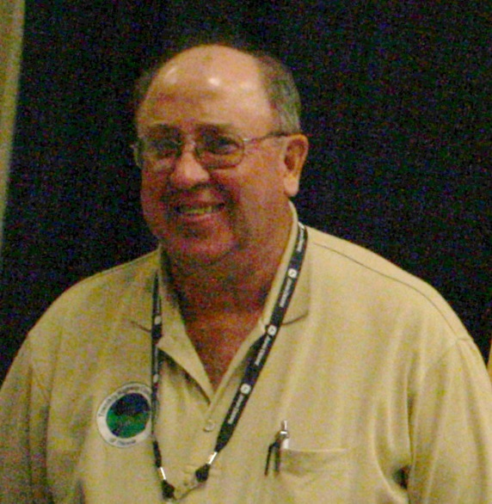
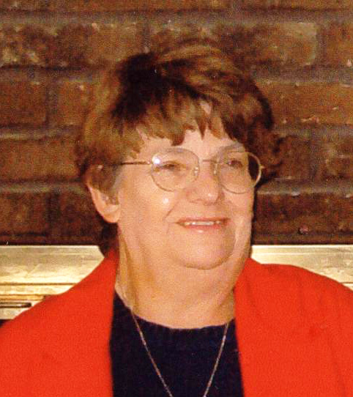
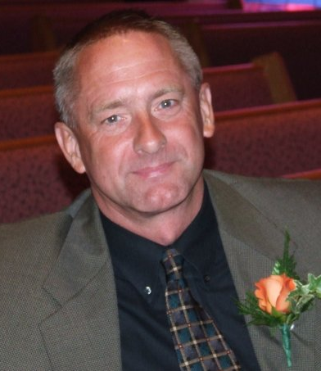
Darrell Maxheimer
Highway Commissioner
Rochester Township
Sangamon County
Karen Megan
Tax Collector
Millbrook Township
Peoria County
Sherry Meadows
Assessor
Mt. Vernon Township
Jefferson County
Charlie Montgomery
Highway Commissioner
Monticello Township
Piatt County

Slide 8
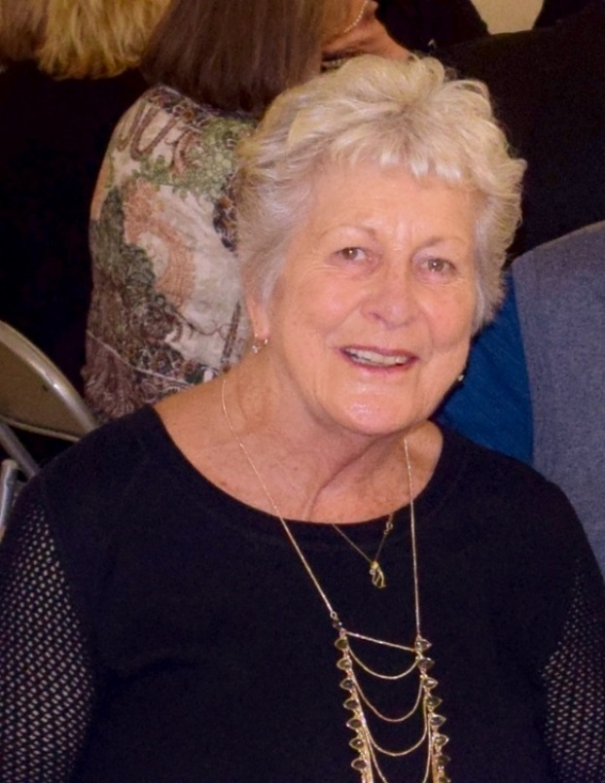
Craig Paulek
Clerk Stonington Township Christian County
Richard Phillips
Trustee
Normal Township
McLean County
Lucy Prouty
Supervisor Ela Township Lake County

Slide 9
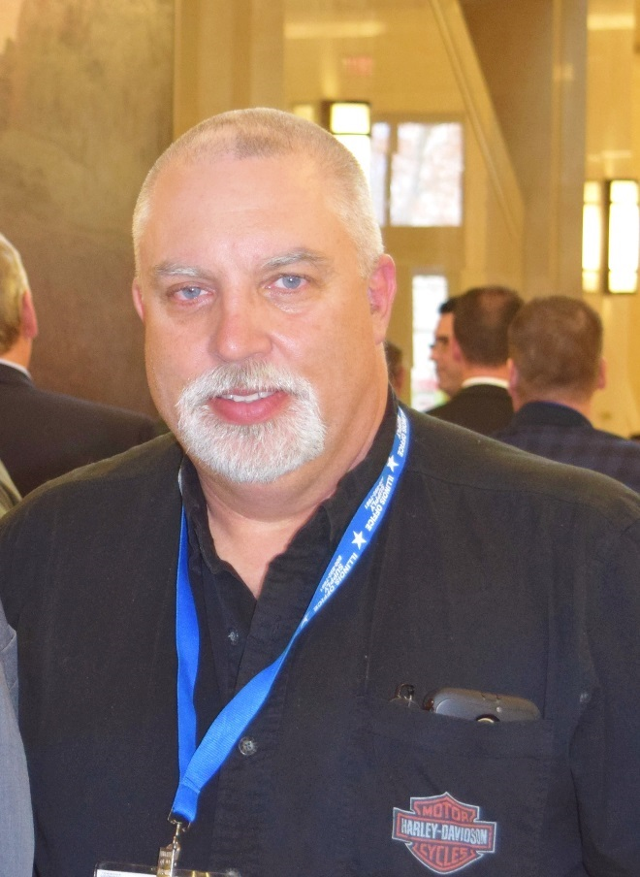
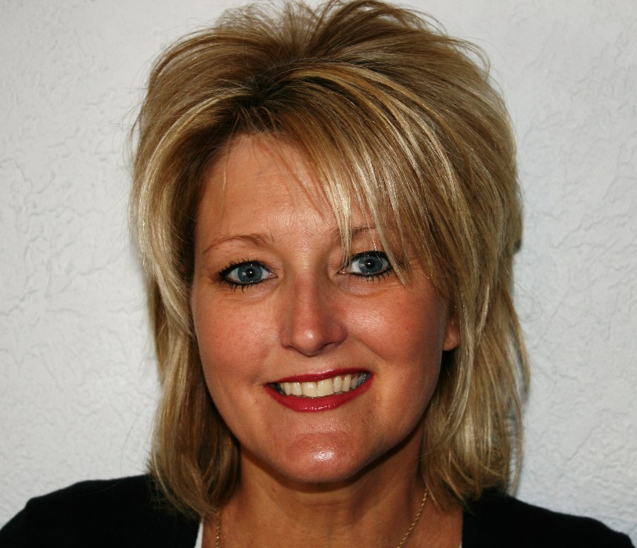
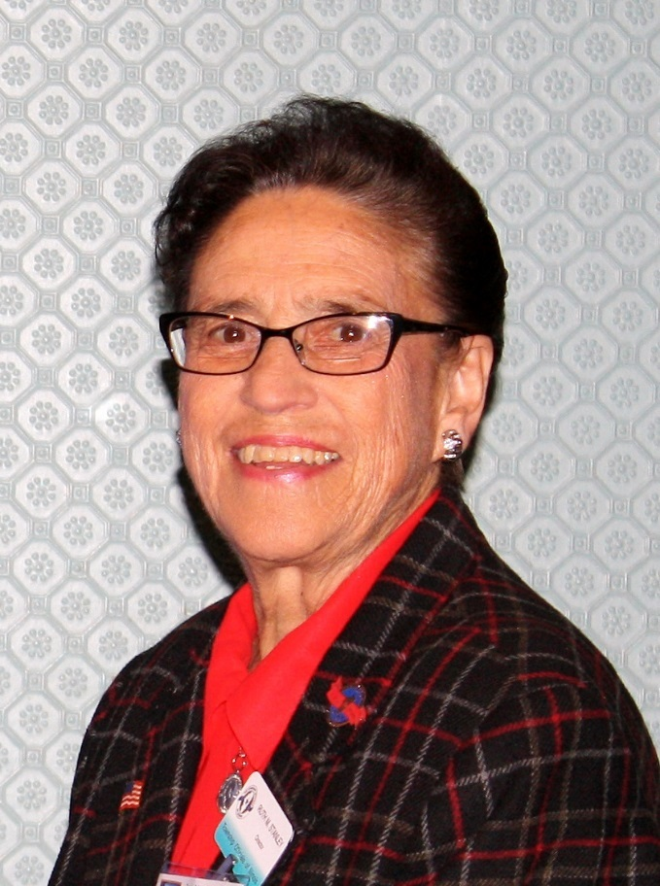
Sherry Tite
Clerk
Wood River Township
Madison County
Arnold Vegter
Highway Commissioner
Union Grove Township
Whiteside County
Ruth Stanley
Trustee
Sterling Township
Whiteside County

Slide 10
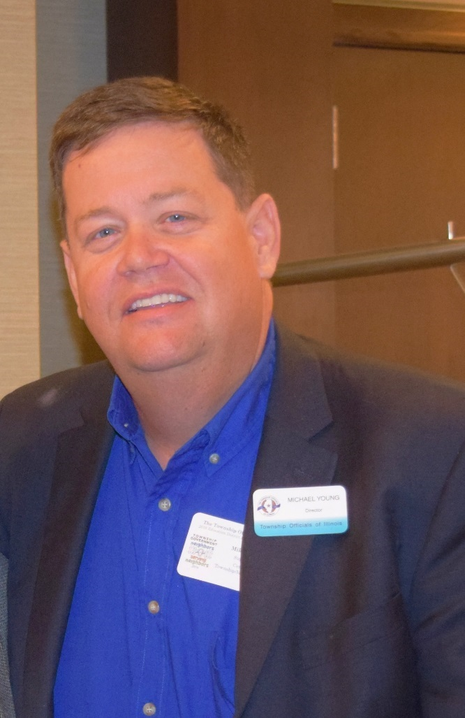
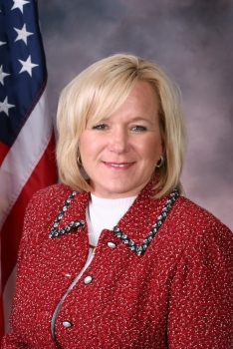
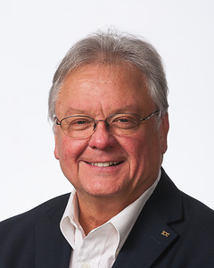
In Memoriam
1949 -2016
Patrick Murphy
Supervisor, Belvidere Township/Boone County
Member of the TOI Supervisors Division
TOI Board member since 2014
Deanna Wilkins
Assessor York Township DuPage County
Michael Young
Supervisor
Centralia Township
Marion County

Slide 11
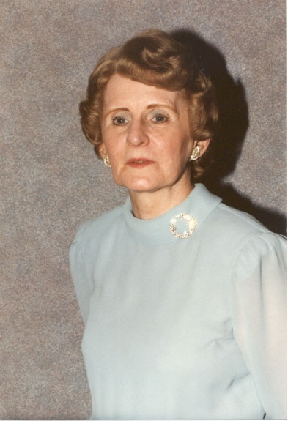
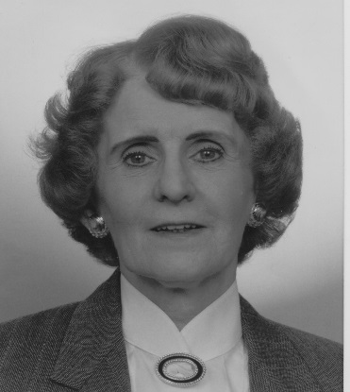
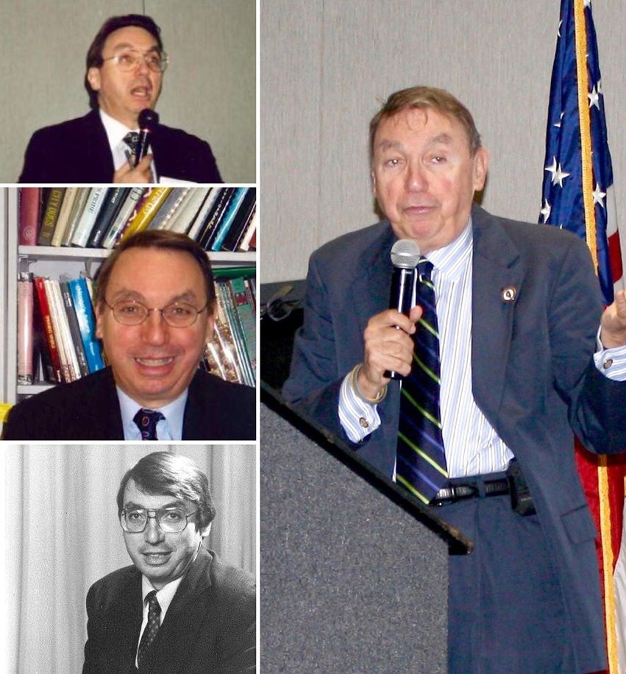
In Memoriam
Dr. Paul Green
1943-2016
Shirley J. Green
1925-2016
Dr. Paul Green was a familiar face at TOI education events in the 1980’s, 1990’s and early 2000’s.
Dr. Green led the charge by putting together training seminars for township officials co-sponsored by
the Illinois Department of Commerce and Community Affairs, Governor's State University's Institute for Public Policy and Administration, and TOI.
He also served as a township official, as Monee Township (Will County) Supervisor from 1977-1983.
Shirley J. Green was TOI’s first female president and a former assessor for Rich Township (Cook County) for 20 years.
Shirley became a member of the TOI Board of Directors in 1977. She served as Secretary of TOI Board 1980-1983, 3rd Vice President of TOI Board 1983-1985, 2nd Vice President of TOI Board 1985-1986, 1st Vice President of TOI Board 1986-1989, President (1989-1991). She also held the office of President of the Cook Township Assessors Organization, President of the Township Officials of Cook County, President of the Illinois Assessment Institute, and served on the TOIRMA Operating Committee. She received an award from the Illinois Township Assessor's Association as well as the Marshall Thoreau award for distinguished professional and personal dedication.

Slide 12
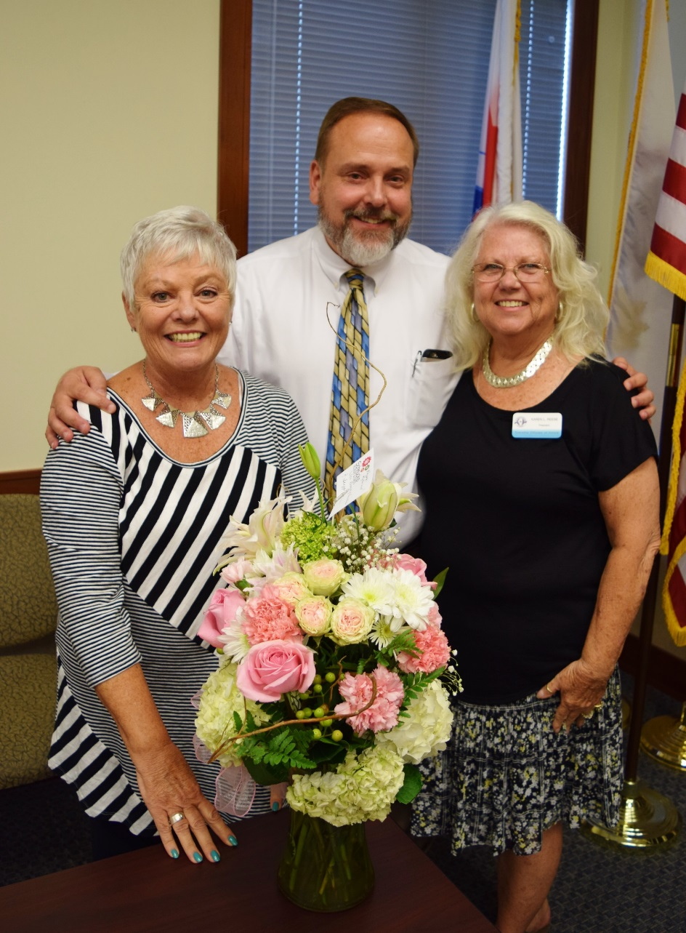
Congratulations to TOI 2nd Vice President/South Rock Island Assessor Susie Carpentier, who retired on August 31. She has been a township assessor since 1993.
Pictured from left to right: TOI 2nd Vice President/South Rock Island (Rock Island County) Assessor Susie Carpentier, TOI Executive Director Bryan Smith, and TOI President/Newell Township (Vermilion County) Assessor Karen Reese.

Slide 13
Thank you to our 2016 conference sponsors and exhibitors!

Slide 14
2016 Conference Sponsors
Platinum Sponsors

Slide 15
2016 Conference Sponsors
Gold Sponsors

Slide 16
2016 Conference Sponsors
Township Officials of Illinois Divisions
Silver Sponsor
App Sponsors

Slide 17
Thank you to everyone who attended and helped make TOI’s 2016 Educational Conference a success. See you next year!

